Slide 1

Football(Soccer) Analytics Project
Merging the Thrill of Soccer with the Precision of Data Analytics
Elizabeth Adomako Boamah
Data Analytics(Fall 2023)

Slide 2

Introduction

Slide 3
Introduction
The Intersection of Passion and Precision
In the dynamic world of football, where passion reigns, data analytics brings a new dimension of precision.
Transforming the Beautiful Game
Data Analytics reshapes football, offering new insights into player performances, match outcomes and so on, revolutionizing the game we love.
Project Scope
An in-depth analysis focusing on three key areas: evaluating player performances, predicting match outcomes and analyzing the impact of betting odds on football.
My Journey from Fan to Analyst
Fueled by my passion for football, this journey reflects a transition from fan to analyst, driven by a desire to delve deeper into the game through the lens of data.

Slide 4

Project Aim and Goals
Aim : To leverage machine learning in analyzing player performance, match outcomes and betting odds analysis.
Goals:
Analyze player performance for talent identification
Develop models to predict match outcomes
Study betting odds and their correlation with the match results

Slide 5








Data Source, Tools and Overview
Data Source : European Soccer Database from Kaggle.(sqlite)
Tools used : Python, pandas for data manipulations, sklearn for machine learning, matplotlib and season for visualization
Dataset components : 25,000 + matched, 10,000+ players, player attributes , team attributes , over 8seasons (2008 to 2016).
Data Tables : Matches, Players, Teams, Leagues, countries.

Slide 6

Exploratory Data Analysis(EDA)

Slide 7
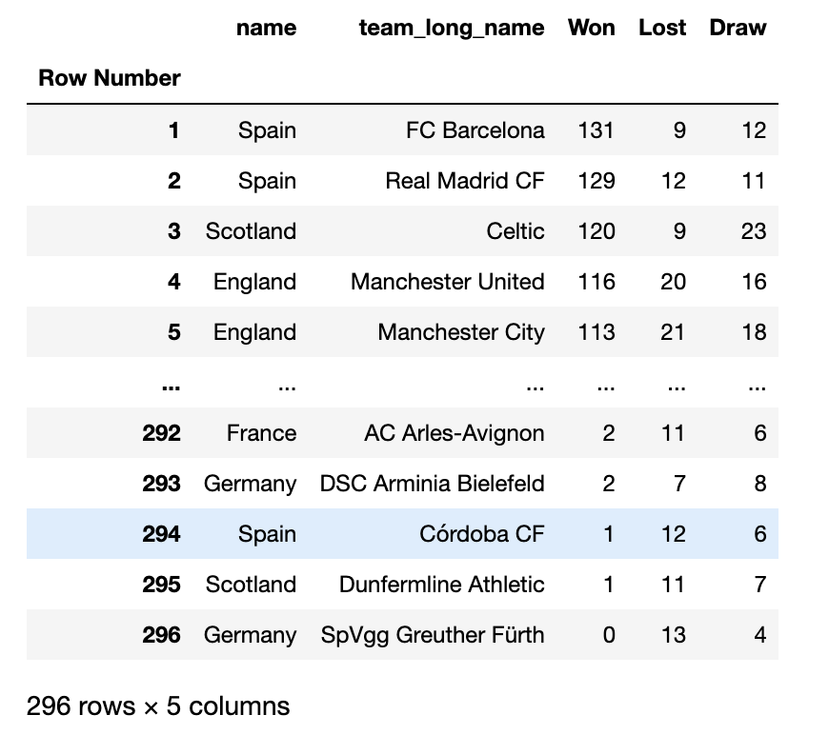
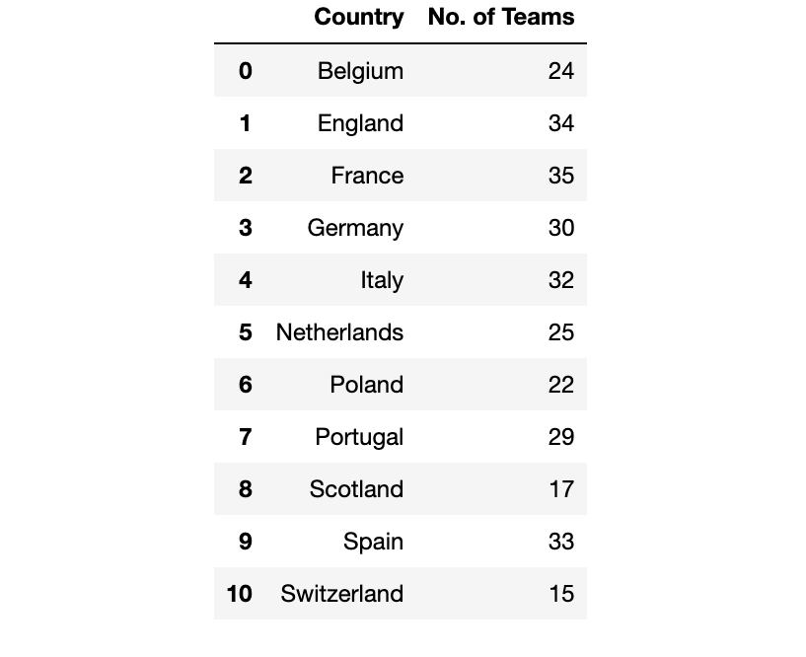
Insights from Preliminary Analysis
Team Analysis
Number of teams per country,indicating the diversity of the dataset
Merge country and teams dataframe and groupby common index
Team Analysis
Number of games won, lost or drawn by various teams

Slide 8
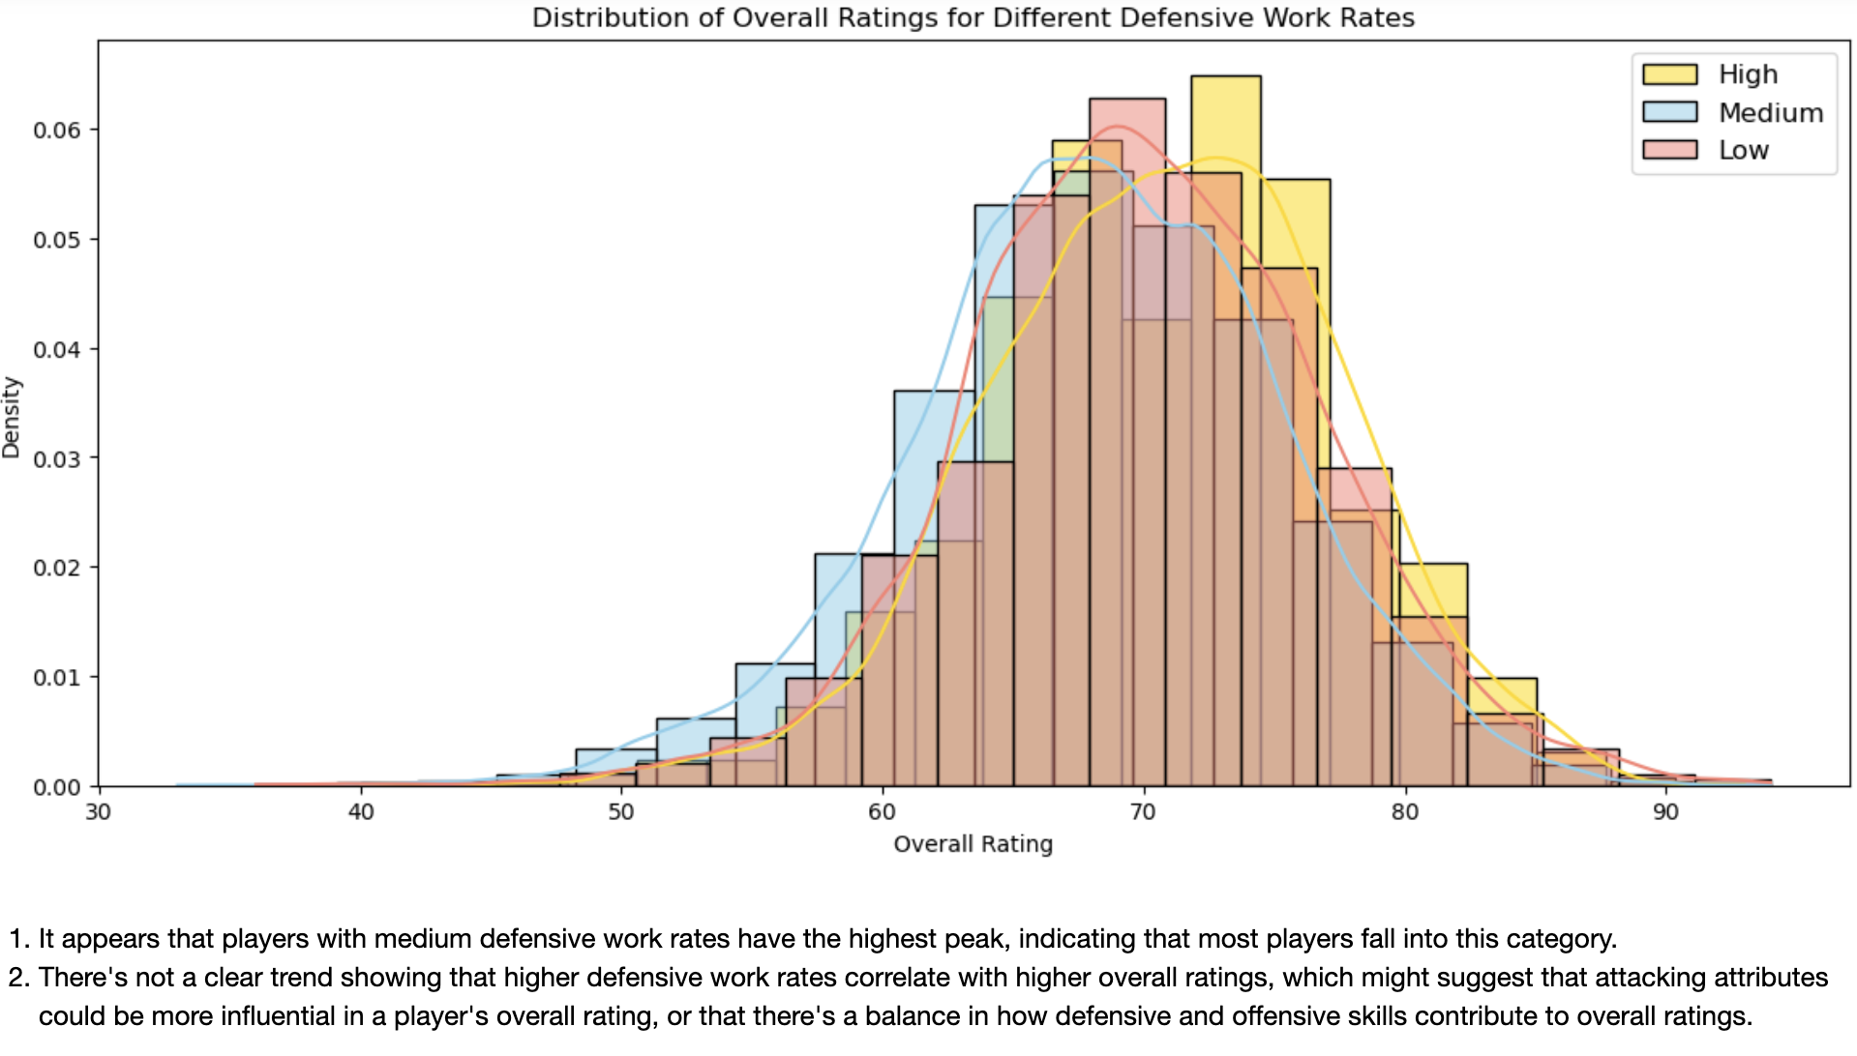
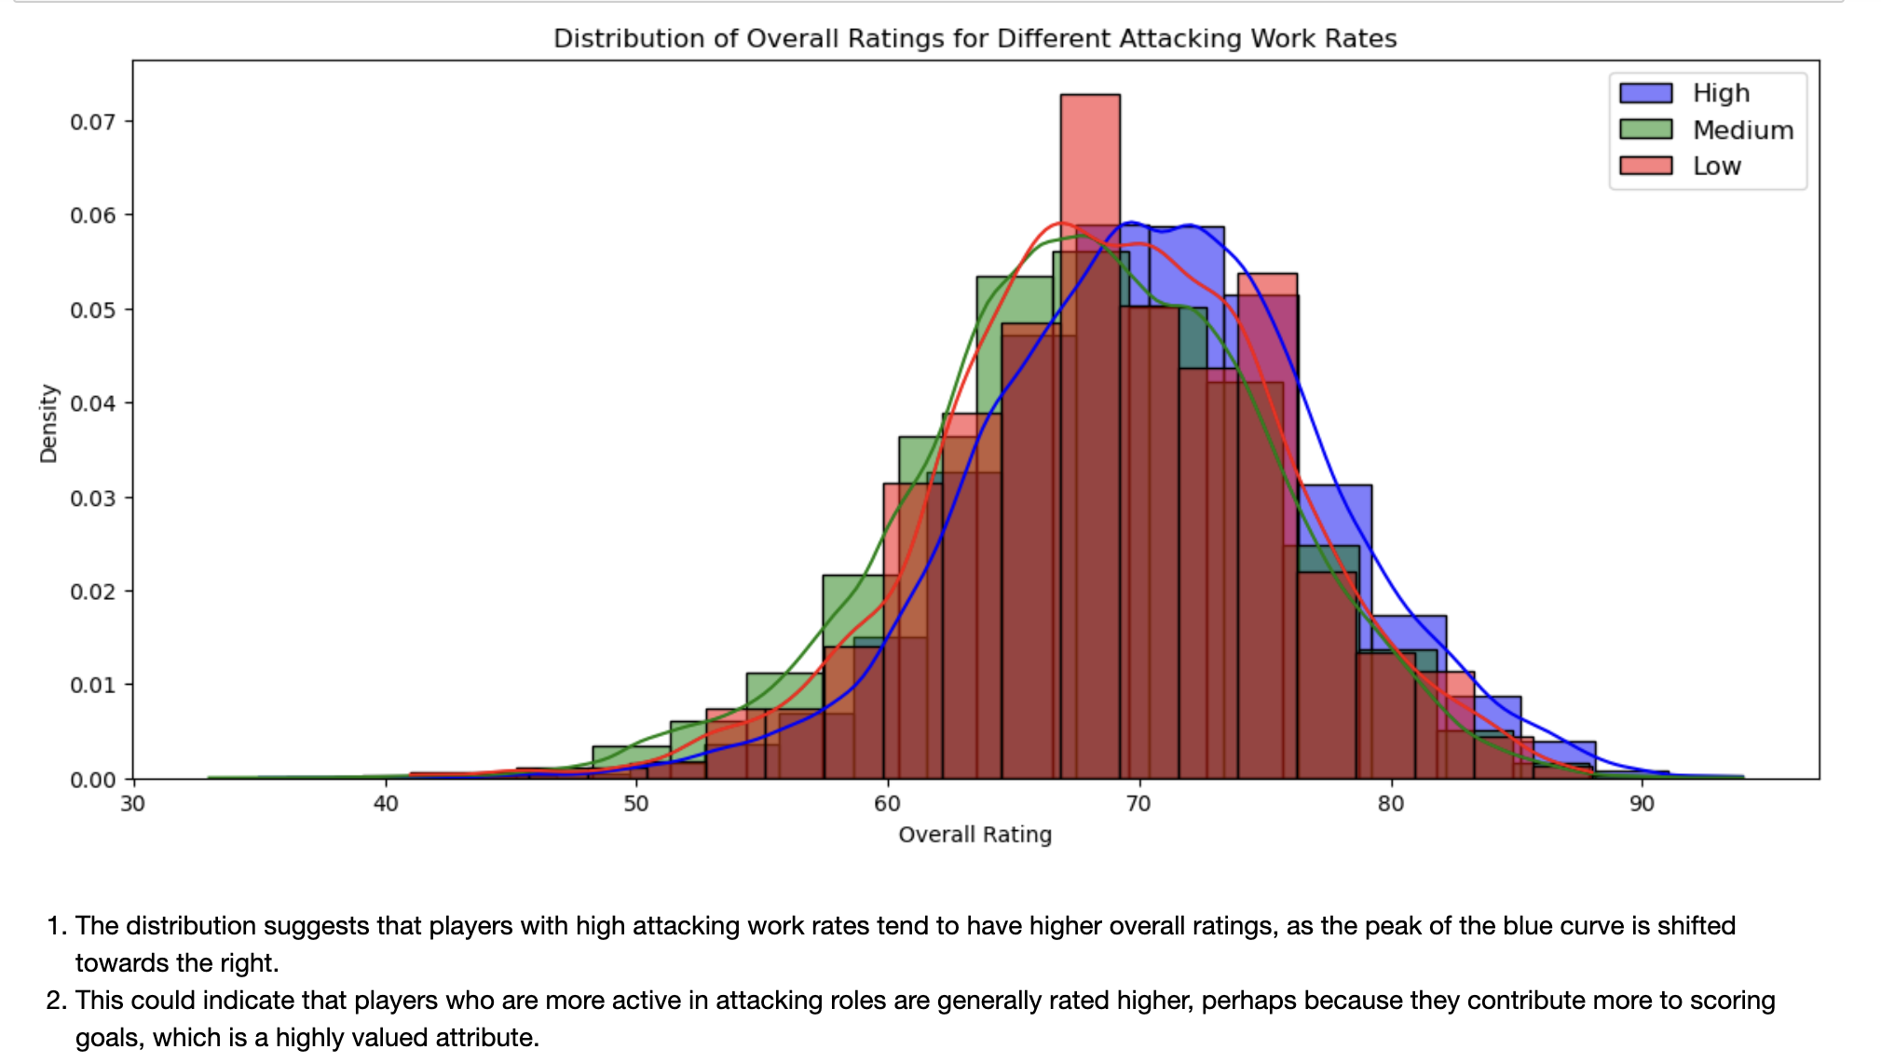
EDA on Player Attributes
Player Attributes
Distribution of ratings for attacking work rates
Distribution of ratings for defensive work rates

Slide 9

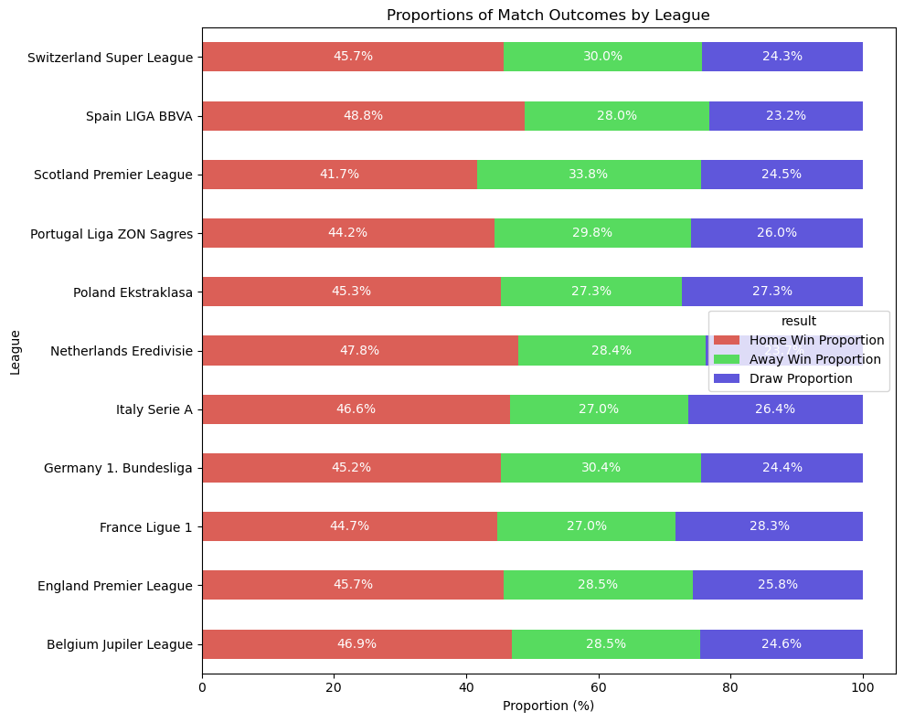
EDA on Match Data
Match Data Highlights

Slide 10

Machine Learning Analysis

Slide 11

Player Performance Analysis - Methodology
Analyzing Player Performance: Approach
Machine learning Models
Utilization of machine learning techniques like Linear Regression, and Random Forest to predict overall player ratings(Goalkeepers and Outfield players).
Data Processing
Cleaning the preprocessing the data, including handling missing values and feature selection for model accuracy.
Feature Analysis
Identification of key features from player attributes dataset such as, dribbling, reaction, crossing, finishing etc.
Train Data
Data was divided into test and training data set (20 to 80).

Slide 12
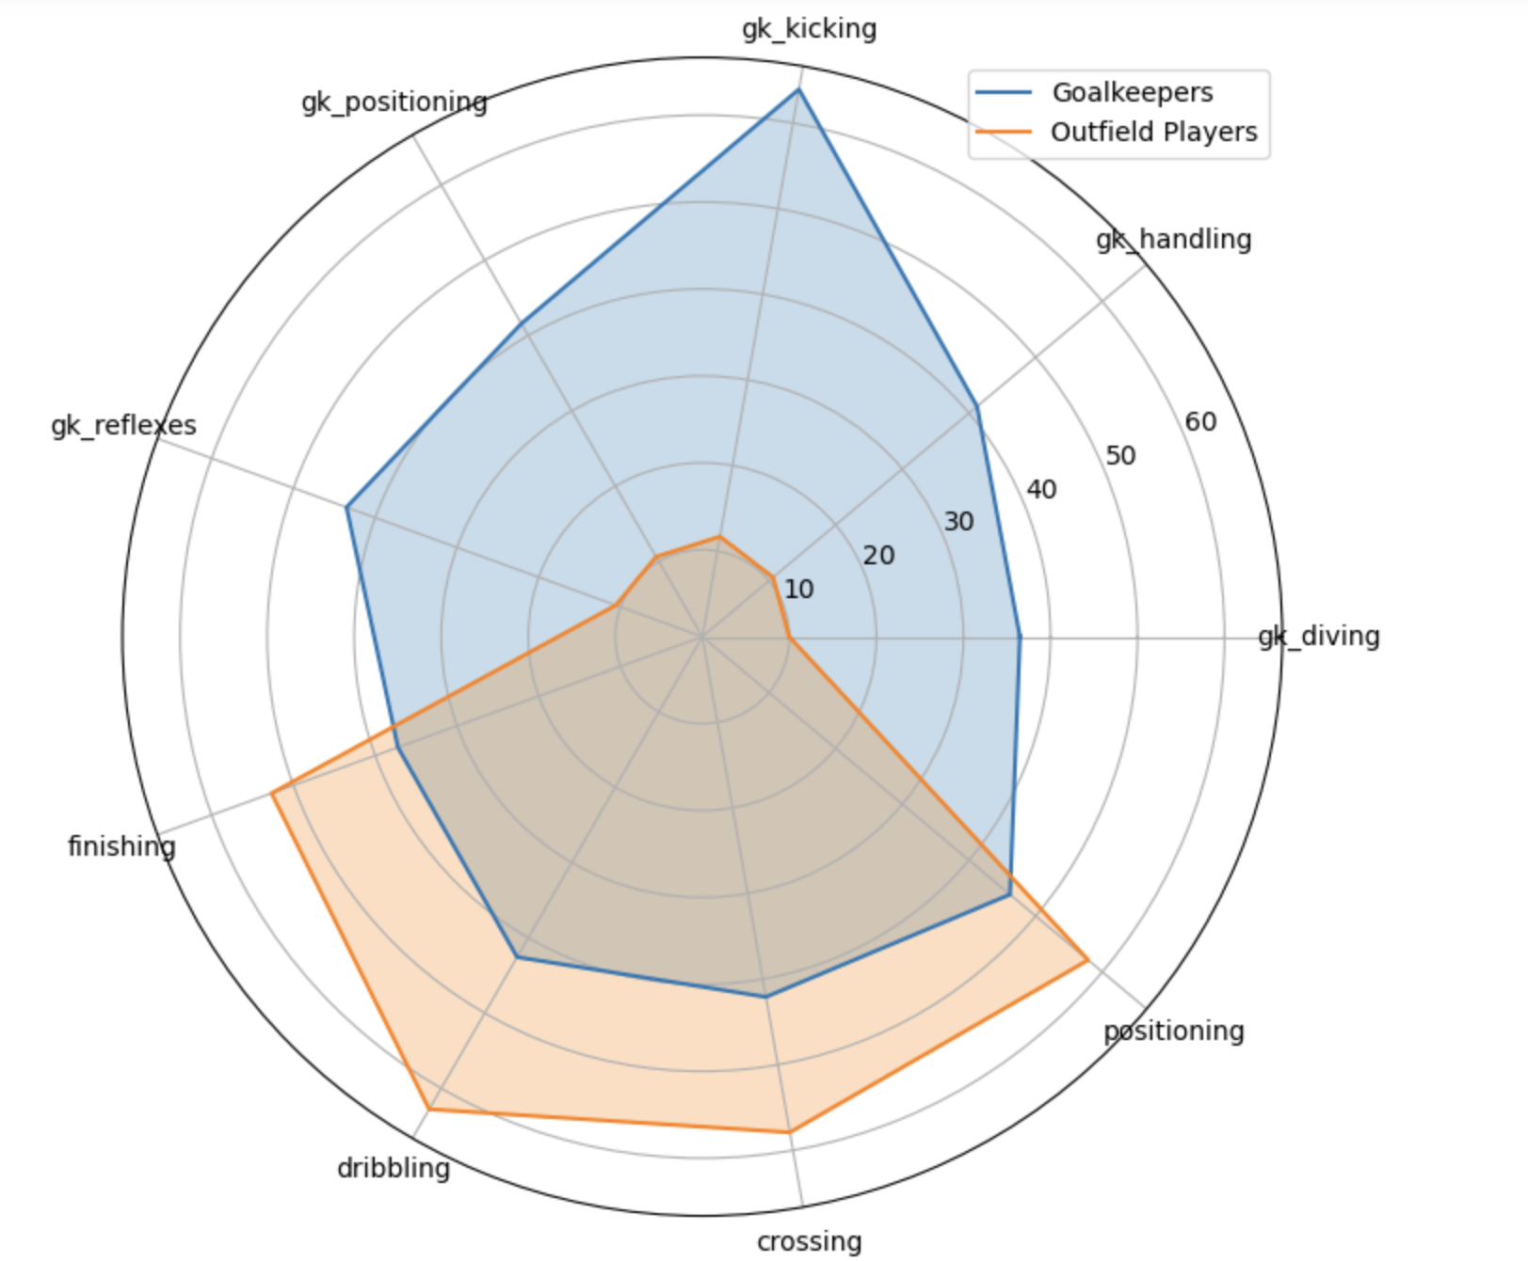
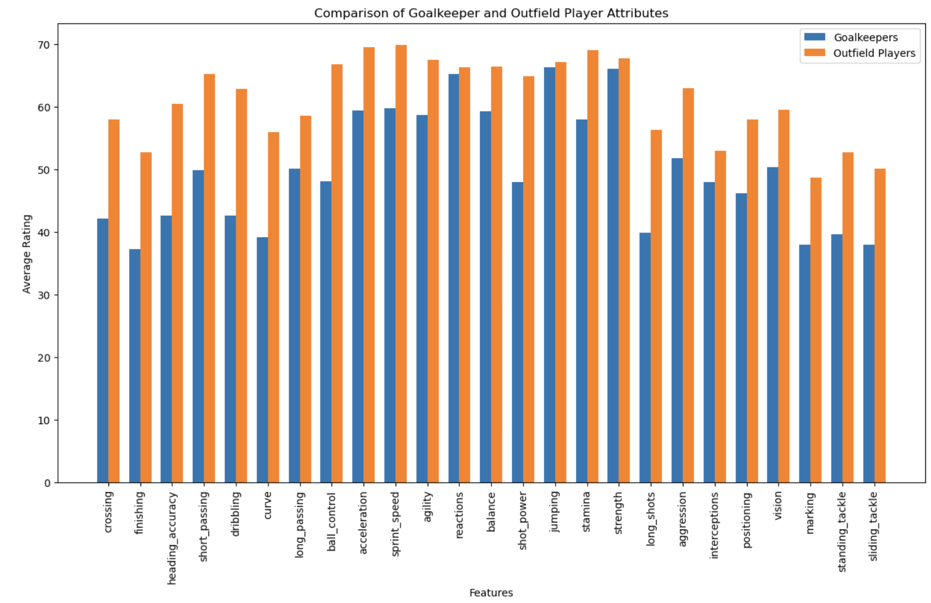
Visualization the Data - Goalkeepers vs Outfield Players
Bar Chart Description
Goalkeepers score higher in reflex-oriented attributes whiles outfield players exhibit superior ratings in control -related attributes
Radar Chart Description
Presents direct comparison in a variety of skills

Slide 13
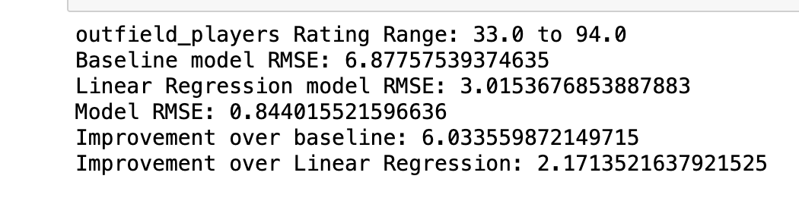
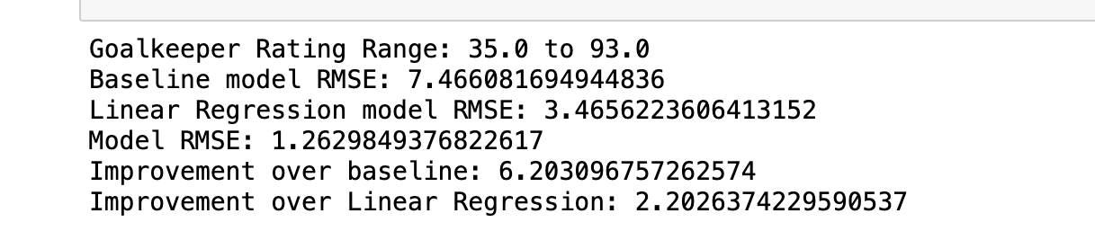
Player Performance Analysis - Key Insights
Model Performances of Goalkeepers and Outfield Players
How the model(RandomForest) performed in showing how player attributes impact overall ratings of players.
The baseline Model : simple model that predicts the mean rating
Linear Regression: measures the relationship between a dependent variable and more independent variables.
Random Forest: Combines multiple decision trees to improve prediction accuracy.
Insights
Random Forest performs very well over the baseline and linear regression models.
The model is quite robust for predicting both outfield players and goalkeepers.
Outfield players
Goalkeepers

Slide 14
Match Outcome Prediction - Methodology
Model Selection
Applied Logistic Regression to solve the classification.
Feature Engineering
Created features such as head to head performances, player ratings, team performance, historical match results etc.
Data Preprocessing
Data was cleaned and preprocessed with categorical outcome encoded numerically to facticilate model training and evaluation.(i.e decide if the match results will be Home win(1) , Away win(2) or Draw(0))

Slide 15

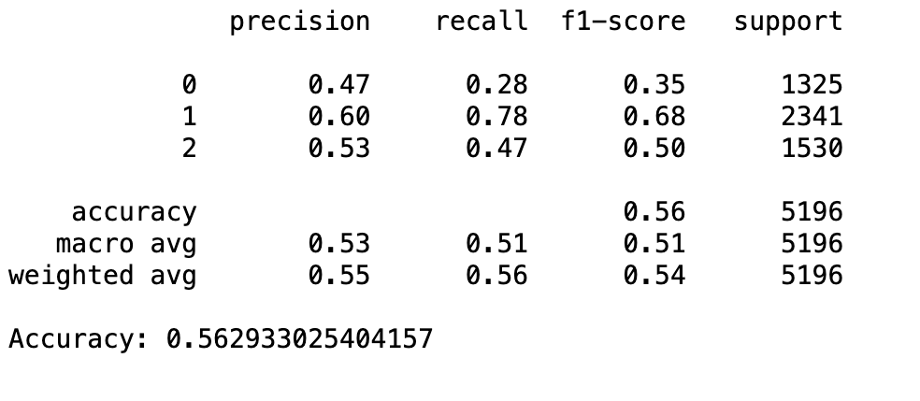
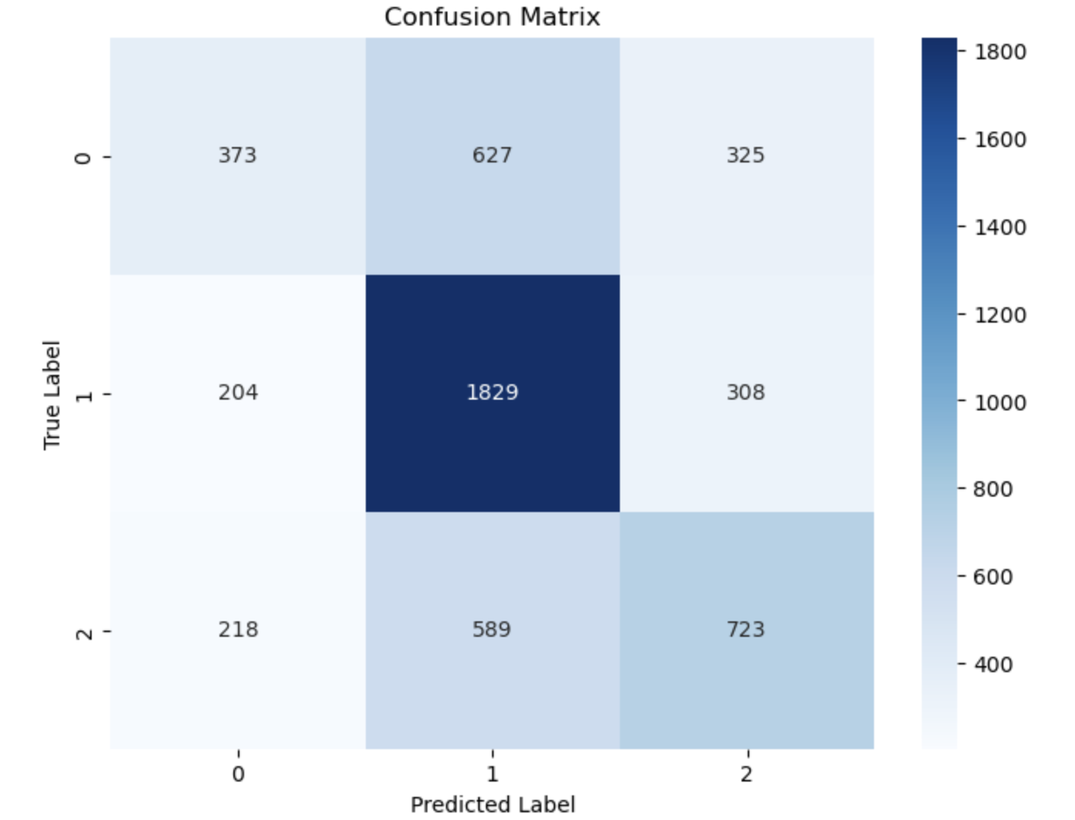
Prediction Match Outcome - Results
Model Performance
The model performance was accessed by the accuracy metrics
Confusion Matrix
Model Accuracy Illustrated.
The model predicted the match outcome with over 50% accuracy which is quite good given how unpredictable the nature of football is.
The model is able effective predict home wins(1) as compared to the others.
The model outperforms a simplistic approach of always predicting a home win.(Not so good)

Slide 16
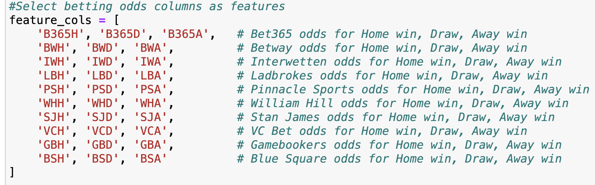
Betting Odds Analysis - Approach
Understanding odds
Explored the relationship between betting odds and actual match outcomes.
Interpreting how odds set by bookmarkers reflect the predicted likelihood of match results
Data Integration
Betting odds data from multiple bookmarkers were integrated in match results to analyse patterns.
Analytical Techniques
Gradient Boosting classifier was used to enhance predictive accuracy by sequentially correcting errors from ensemble of decision trees..

Slide 17
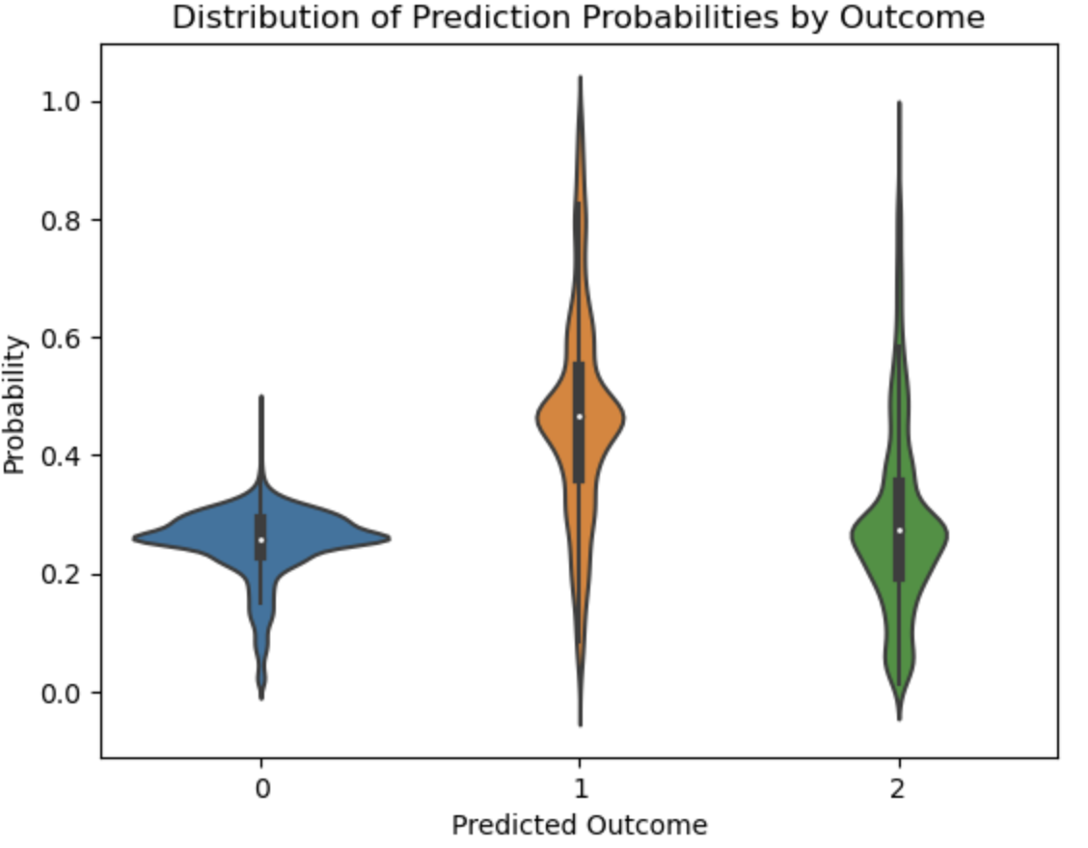
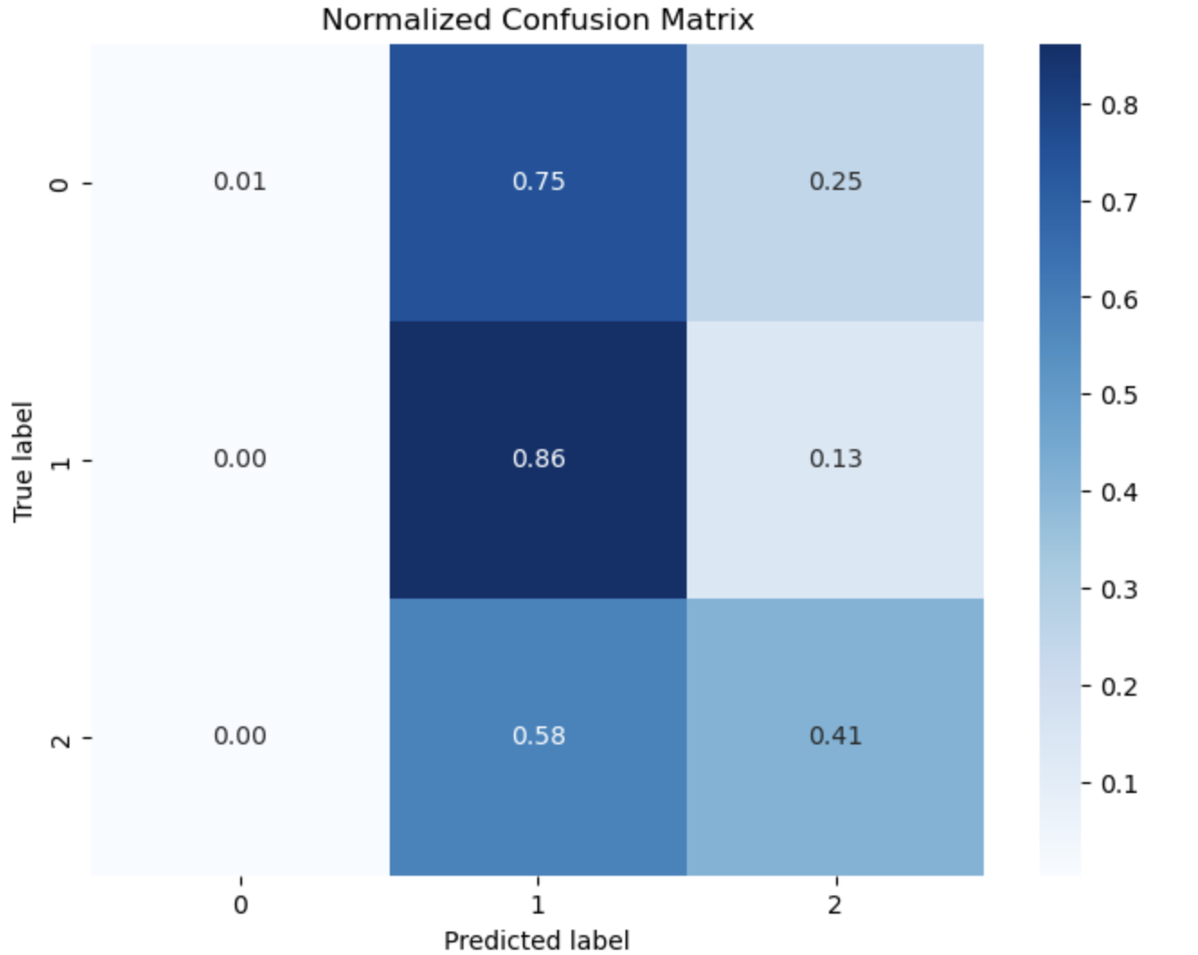
Betting Odds Analysis -Findings
Predictive Power of Odds
The model is most confident in predicting home wins , as reflected by the narrow distribution centered around a higher mean probability.
Predictions for draws are less confident and away win predictions show variance.

Slide 18
Navigating Through Challenges
Data Cleaning Challenges
Joining and merging different data frames lead to long run times
Model selection
Had to try different models as some worked better than others. Experimented with various models such as Linear Regression, Support Vector Machines etc.
Solutions Implemented
Careful data merging, dropping of missing values and rigorous feature engineering

Slide 19
Applications and The Way Forward
Football Analytics equips teams, coaches with tools for scouting and player assessment which ensure that talent acquisition is data-driven.
Betters and analyst gain an understanding of market trends and biases which enable more successful bets( but luck counts a lot in Football!)
Further Research:
Incorporating additional data and also obtaining more recent datasets.

Slide 20
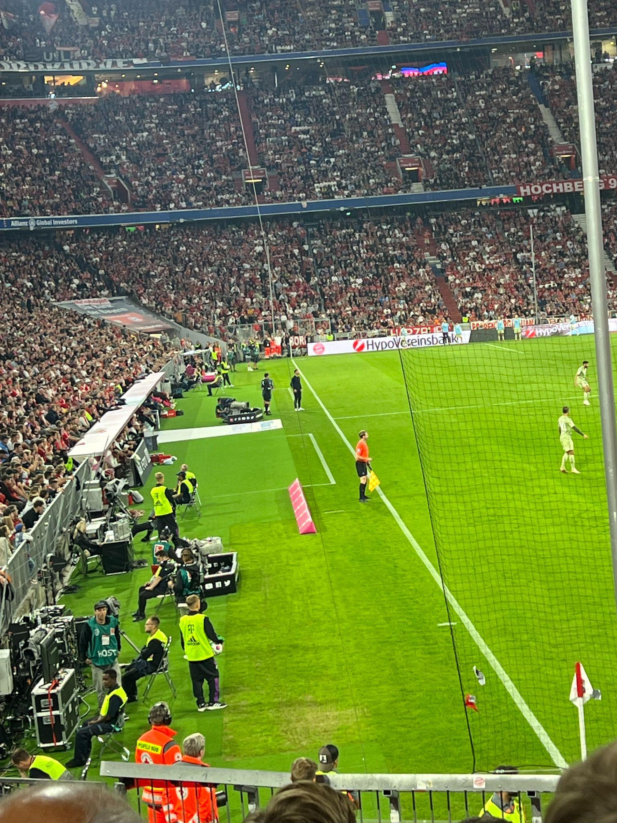
Concluding Insights
Summary
This project underscores the transformative potential of data analytics in football from elevating player performance to refining match outcome predictions.
Reflections
My journey from a football fan to an analyst has been profound, blending my love for the sport with the precision of data analytics for well informed insights.

Slide 21
Special Thank you to the all teachers…!!!
AnyQuestions?!!

Slide 22


Thanks a lot!
Contact
Elizabeth Boamah
elizabeth.boamah@tum.de

